Slide 1
Data Warehouses
Chapter 2

Slide 2
Chapter 2 Outline
  Introduction
  Data Warehouses
  Data Warehouse in Organisation
  OLTP vs. OLAP
  Why Separate Data Warehouse?
  A multi-dimensional data model

Slide 3
Data Warehouses
According to the original definition of Bill Inmon (1996), the father of data warehouses, a data warehouse is a subject-oriented, integrated, time-variant, non-volatile collection of data in support of management’s decision-making process.

Slide 4
Data Warehouse—Subject-Oriented
Organized around major subjects, such as customer, product, sales.
Focusing on the modeling and analysis of data for decision makers, not on daily operations or transaction processing.
Provide a simple and concise view around particular subject issues by excluding data that are not useful in the decision support process.

Slide 5
Data Warehouse—Integrated
Constructed by integrating multiple, heterogeneous data sources
  relational databases, flat files, on-line transaction records
Data cleaning and data integration techniques are applied.
  Ensure consistency in naming conventions, encoding structures, attribute measures, etc. among different data sources
    E.g., Hotel price: currency, tax, breakfast covered, etc.
  When data is moved to the warehouse, it is converted.

Slide 6
Data Warehouse—Time Variant
The time horizon for the data warehouse is significantly longer than that of operational systems.
  Operational database: current value data.
  Data warehouse data: provide information from a historical perspective (e.g., past 5-10 years)
Every key structure in the data warehouse
  Contains an element of time, explicitly or implicitly
  But the key of operational data may or may not contain “time element”.

Slide 7
Data Warehouse—Non-Volatile
A physically separate store of data transformed from the operational environment.
Operational update of data does not occur in the data warehouse environment.
  Does not require transaction processing, recovery, and concurrency control mechanisms
  Requires only two operations in data accessing:
    initial loading of data and access of data.

Slide 8
data warehouses
are the foundation of the business IT infrastructures that collect data from several dispersed information sources and are designed to allow decision makers have prompt access to information for purpose of reporting

Slide 9
Data Warehouse in Organisation
Aetna Life uses IBM’s data warehouse and data mining tools to have a better understanding for meeting the specific needs of its customers
  to estimate the performance of new products and services.
Guinness Limited is a British company that has achieved its ability to be a major global force
- while serving the local market needs to overcome the difficulties of extracting data from transaction processing systems for populating a data warehouse with valuable business information

Slide 10
Data Warehouse in Organisation
Parkson Corporation Sdn Bhd is a Malaysian company that has increased marketing program efficiency and market share through implementation of data warehouse and data mining to work for its 29 stores in Malaysia

Slide 11
Data Warehouse in Organisation
According to SAS Asia Pacific Risk Management Practice head, John Foulley said many banks in Malaysia had the problem of integrating their data efficiently and this had led to misplacement of information and poor quality data .
According to this statement, most of Malaysian banks do not have implementation of data warehouse yet. The local banks have to implement Basel II framework was instructed by Bank Negara for it is either 2008 or 2010.
The framework addresses on credit and operational risks which requires the ready of data warehouse.

Slide 12
Data Warehouse in Organisation
Alliance Banking Group allocated 36 million to build data warehouse.
Insurance Services Malaysia handles more than 50 insurance companies in Malaysia. They require insurance companies to deliver clean, structured data to them to build the data warehouse.

Slide 13
Data Warehouse in Organisation
According to Malaysia's EON Bank, they have problem to access the complete view of the customer due to loan information sitting in one transactional system and credit details in another system.
the AmBank Group has invested over RM10 million involving the implementation of data integration and management solution.

Slide 14
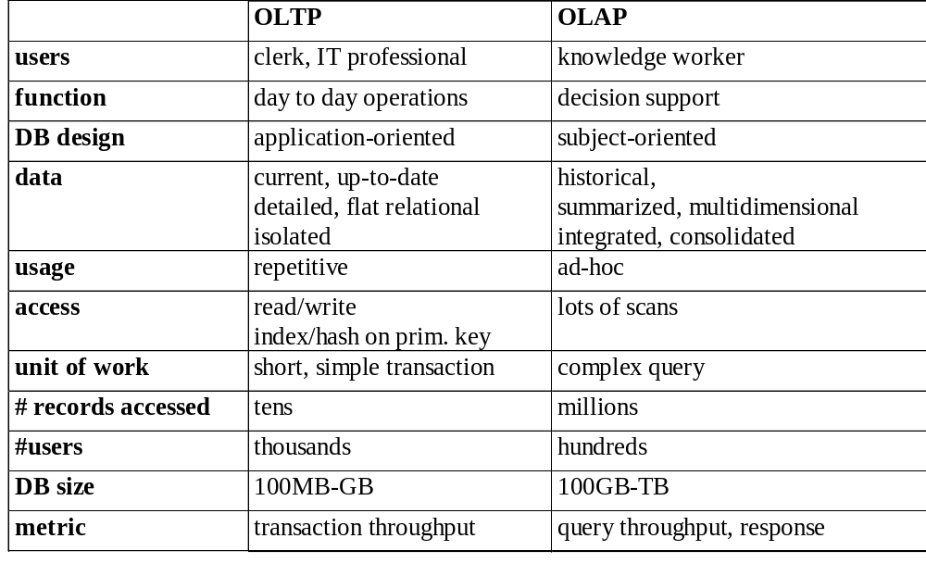
OLTP vs. OLAP

Slide 15
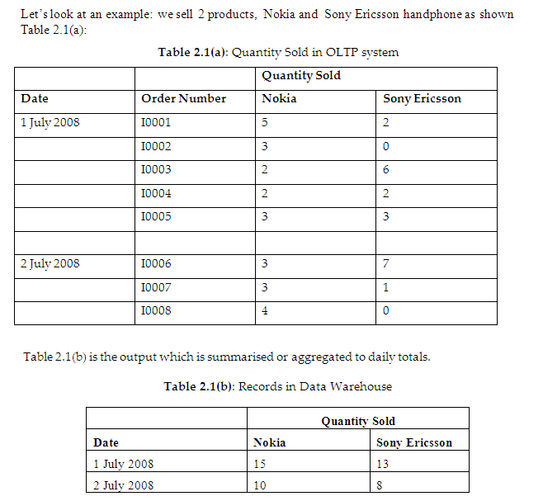

Slide 16
Why Separate Data Warehouse?
High performance for both systems
  DBMS— tuned for OLTP: access methods, indexing, concurrency control, recovery
  Warehouse—tuned for OLAP: complex OLAP queries, multidimensional view, consolidation.
Different functions and different data:
  missing data: Decision support requires historical data which operational DBs do not typically maintain
  data consolidation: DS requires consolidation (aggregation, summarization) of data from heterogeneous sources
  data quality: different sources typically use inconsistent data representations, codes and formats which have to be reconciled

Slide 17
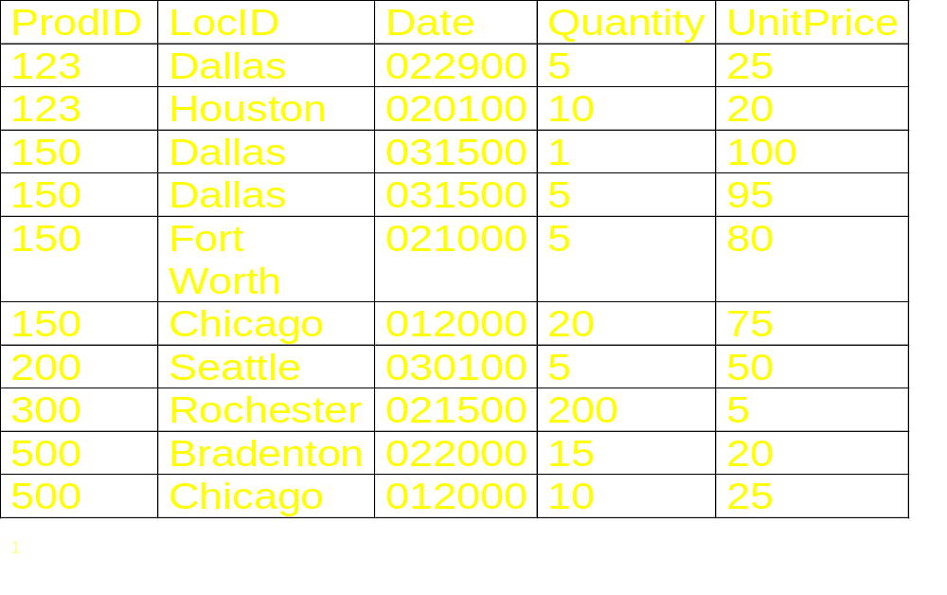
Relational View of Data/ Spreadsheet

Slide 18
From Tables/ Relations and Spreadsheets to Data Cubes
A data warehouse is based on a multidimensional data model which views data in the form of a data cube
A data cube, such as sales, allows data to be modeled and viewed in multiple dimensions
  Dimension tables, such as item (item_name, brand, type), or time(day, week, month, quarter, year)
  Fact table contains measures (such as dollars_sold) and keys to each of the related dimension tables

Slide 19
Conceptual Modeling of Data Warehouses
Modeling data warehouses: dimensions & measures
  Star schema: A fact table in the middle connected to a set of dimension tables
  Snowflake schema: A refinement of star schema where some dimensional hierarchy is normalized into a set of smaller dimension tables, forming a shape similar to snowflake

Slide 20
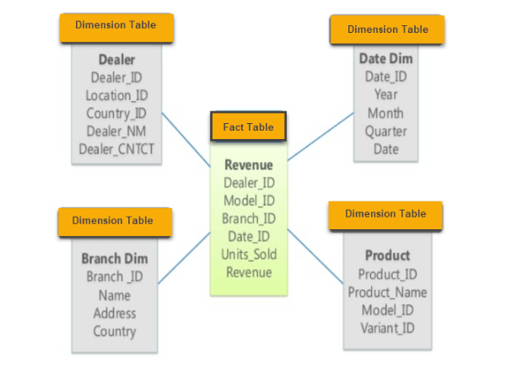
Star Schema

Slide 21
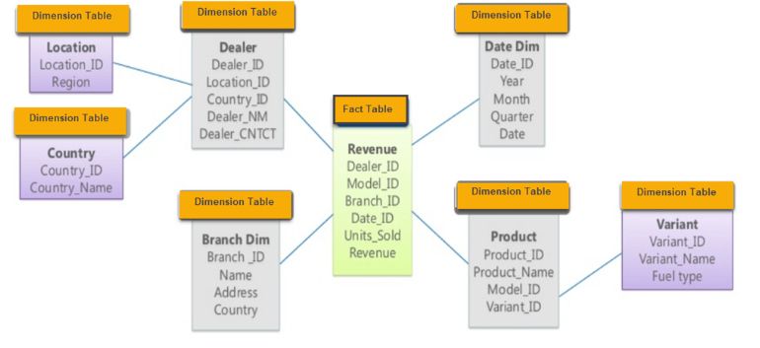
Snowflake Schema

Slide 22
The main characteristics of star schema:
Simple structure -> easy to understand schema
Great query effectives -> small number of tables to join
Relatively long time of loading data into dimension tables -> de-normalization, redundancy data caused that size of the table could be large.
The most commonly used in the data warehouse implementations -> widely supported by a large number of business intelligence.

Slide 23
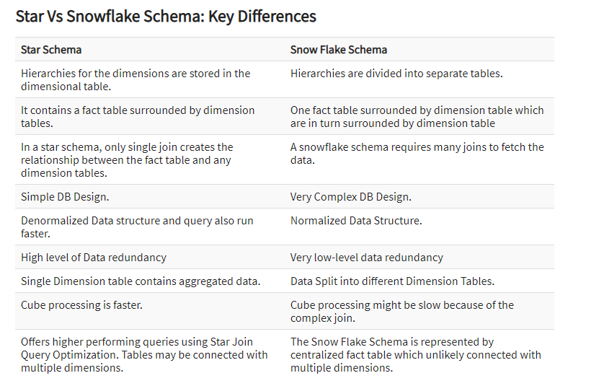
Star vs. Snowflake

Slide 24
Multidimensional Data
Sales volume as a function of product, month, and region
Dimensions: Product, Location, Time
Hierarchical summarization paths
Region
Industry Region Year
Category Country Quarter
Product City Month Week
Office Day
Product
Month

Slide 25

A Sample Data Cube
Date
Total annual sales
of TV in U.S.A.
1Qtr
2Qtr
3Qtr
4Qtr
sum
Product
TV
PC
U.S.A
VCR
sum
Canada
Country
Mexico
sum
All, All, All

Slide 26

Browsing a Data Cube
Visualization
OLAP capabilities
Interactive manipulation

Slide 27
Typical OLAP Operations
Roll up (drill-up): summarize data
  by climbing up hierarchy or by dimension reduction
Drill down (roll down): reverse of roll-up
  from higher level summary to lower level summary or detailed data, or introducing new dimensions
Slice and dice:
  project and select

Slide 28
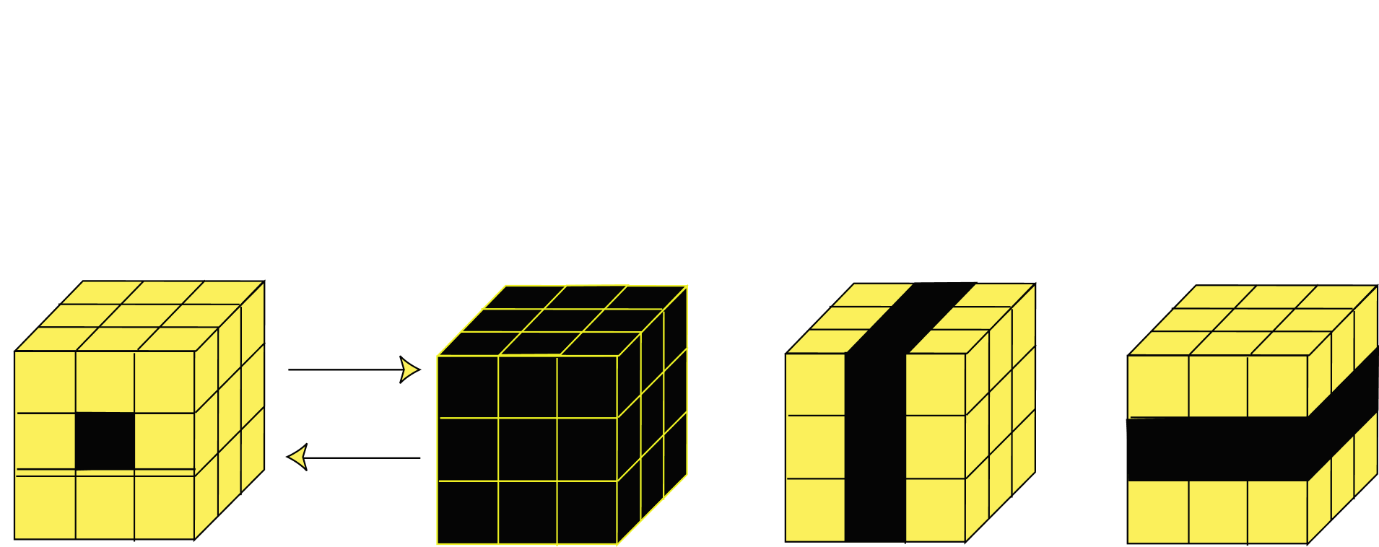
OLAP Operations
Roll Up
Drill Down
Single Cell
Multiple Cells
Slice
Dice

Slide 29
